Slide 1

Theoretical Sampling
Sampling with replacement
Total possible samples = $N^{n}$
$N$ is the size of the population
$n$ is the size of the samples

Slide 2

Experimental Sampling
Sampling without replacement
Total possible samples = $\frac{N!}{n!\left(N−n\right)!}$
$N$ is the size of the population
$n$ is the size of the samples

Slide 3
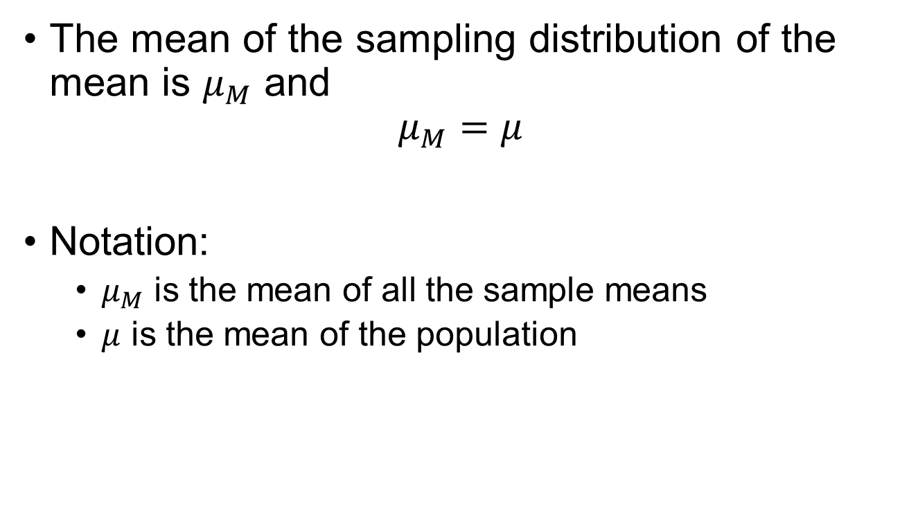
The Mean of the Sampling Dist.
The mean of the sampling distribution of the mean is $μ_{M}$ and
$$μ_{M}=μ$$
Notation:
$μ_{M}$ is the mean of all the sample means
$μ$ is the mean of the population

Slide 4
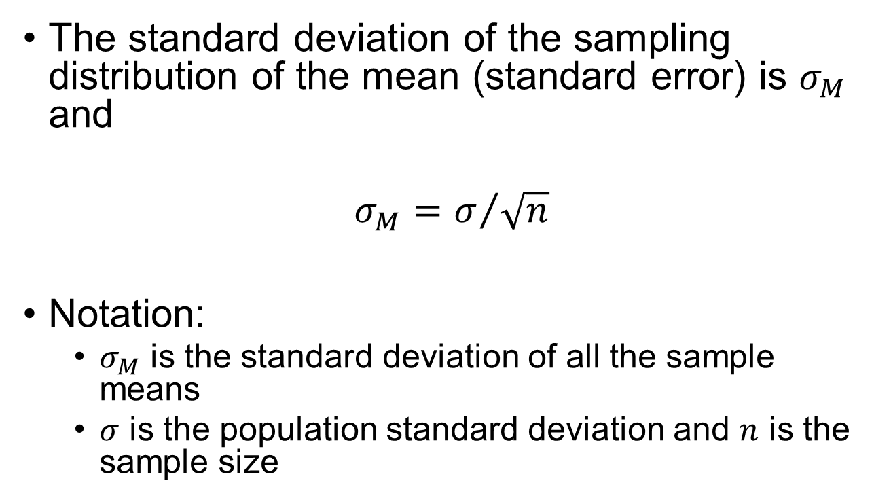
Standard Error
The standard deviation of the sampling distribution of the mean (standard error) is $σ_{M}$ and
$$σ_{M}=σ/{\sqrt{n}}$$
Notation:
$σ_{M}$ is the standard deviation of all the sample means
$σ$ is the population standard deviation and $n$ is the sample size

